Slide 1



« LES CHAMPIONS DE LA PETITE ENFANCE » SYMPOSIUM
The Neurolinguistic Approach (NLA)
Cameron Mitchell and Lyne Gratton
Notes:
Qui a déjà suivi la formation ?
Quelle année enseignez-vous? Est-ce que ça fonctionne? Est-ce qu’il y a une compétence que vous favoriser plus qu’une autre?

Slide 2

“A picture is worth a thousand words”
Find a photo on you cell phone and share the story of this photo with someone you don’t know. (2 minutes)
What do you notice following this conversation?
Notes:
Raise your hand if you conjugated verbs before speaking to your new friend?
Raise your hand if you reviewed the exceptions of the English language such as “i before e except after c”?
Raise your hand if you reviewed a list of vocabulary words before starting your conversation?
Do you need to know the rules of the language, grammar, verb conjugation, and all the vocabulary in order to convey a message?
How did you get there?
If I redid the same activity in French, how would it be different for you?
If I redid the same activity in Spanish, how would it be different for you? La playa es excelente. The Spanish speaker would say…Ah, si, la playa es muy bonita.

Slide 3
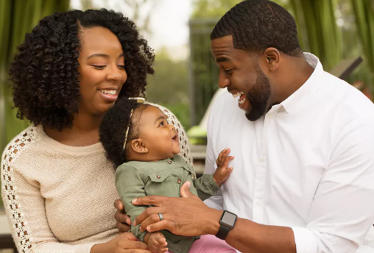
How does a baby learn to speak?
The importance of phonological awareness.
It’s the prep work for the brain to learn how to read and write.
Notes:
Let switch now to our role as educators and our task of teaching our students French.

Slide 4

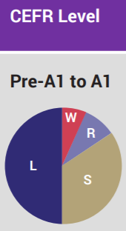
LOOK AT THE CIRCULAR DIAGRAM BASED ON THE CEFR LEVELS AT THE PRE-A1 AND A1 LEVELS.
WHAT STANDS OUT FOR YOU?
L=Listening S=Speaking R=Reading W= Writing
Source: Transforming FSL, Resource: « Grammaire en Action »

Slide 5
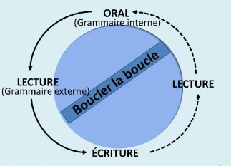

THE NEUROLINGUISTIC APPROACH (NLA)
It is a method of teaching and acquiring any second or foreign language.
The NLA focuses on enabling educators and students to speak French spontaneously within authentic contexts and stages: listening/oral 🡪 reading 🡪 writing 🡪 reading 🡪 listening/oral

Slide 6

The Steps of Oral Communication with the NLA
 | Contextualisation: The educator presents the theme or subject. Exemple: « J’aime le vert. C’est ma couleur préférée. »
1. | The educator models the language structure. Exemple: « J’aime le vert. Quelle couleur est-ce que tu aimes? »
2. | The educator asks the question to a few students. Exemple: « J’aime le vert. Cameron, quelle couleur est-ce que tu aimes? »
3a. | With the educator’s assistance, a student will ask the question to another student. Exemple: « Sophia, pose la question à Jacob. La question est: Quelle couleur est-ce que tu aimes? »
3b. | With the educator’s assistance, two students will model the question and the answer in front of the class.
4. | In groups of two, student A will ask the question to student B (and vice versa) 🡪 limited time
5. | The educator asks a few students about the partner’s answer 🡪 the listening intention
6. | In different groups of two, student C will ask the question to student D (and vice versa) 🡪 limited time.
7. | The educator asks a few students about the partner’s answer 🡪 the listening intention
8. | Summative activity Exemple: « Trouve deux amis qui aime le bleu. »
Notes:
I do - The teacher model.
We do - Students modelling in front of class
You do - Step 6

Slide 7

OBSERVATIONS
How does the teacher get the students to speak in French?
Are the students engaged?
What is the language structure?
How does the teacher support students who are hesitant or make a mistake?
Why is it important to invite two students to model the use of the structure in front of the class?
How is the final activity (“activité synthèse”) enjoyable for students?
What did you notice?

Slide 8

If you were to learn a foreign language such as Portuguese or Polish, how would you want to learn it?
And how would you not want to learn it?

Slide 9
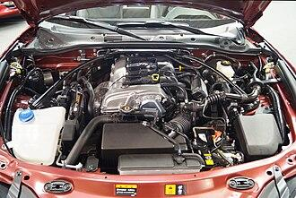
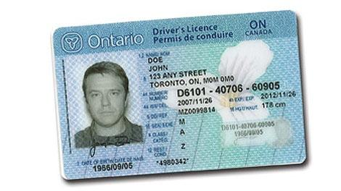
Can you drive a car without knowing the parts of the motor?
Can you speak a language without knowing its formal grammar, rules and exceptions?
Notes:
Children speak their native language years before anyone teaches them explicitly a verb conjugaison , an exception, or a syntax rule. They are speaking without ever opening a grammar textbook.

Slide 10
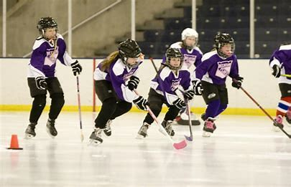
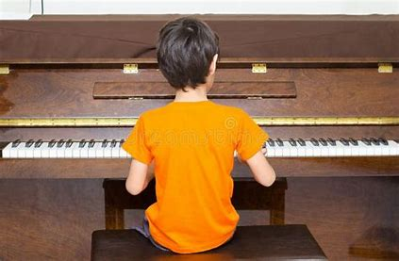
With the NLA, educators and students speak in French
How does a child learn to play hockey?
How does a child learn to play the piano?
How does a child learn to speak?
Notes:
Educators must speak in French. If you say the message in French and then translate to English, guess what? Students will wait for the English message.

Slide 11
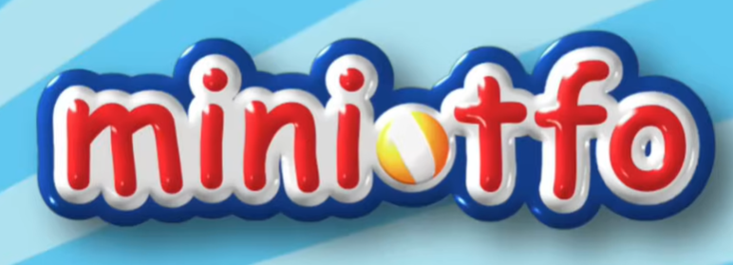
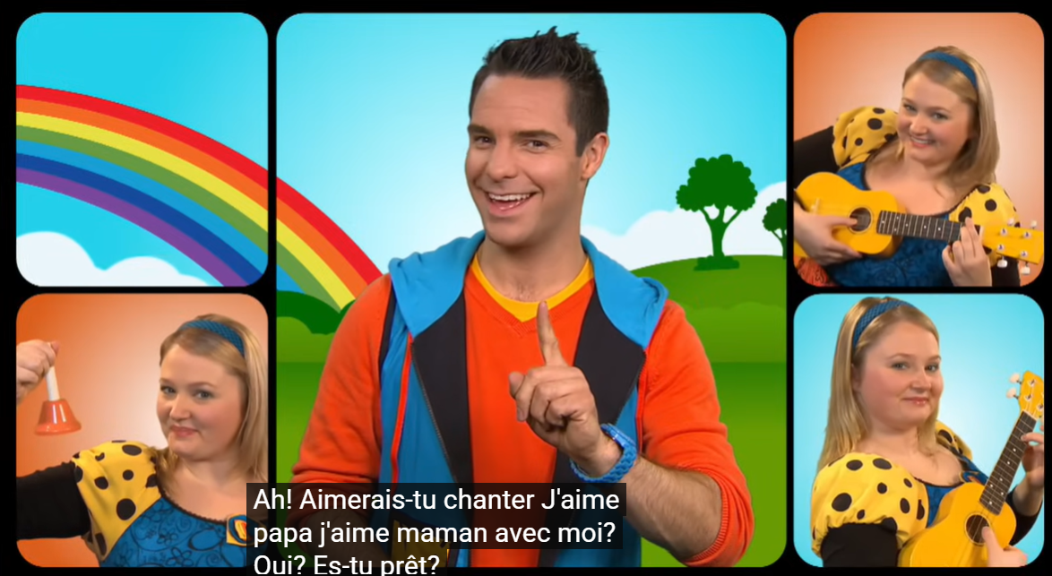
WHAT COMES AFTER THE ORAL STAGES?
Use and reuse the same structure in different authentic contexts.
Examples in French: J’aime, Je n’aime pas, Nous aimons, Nous n’aimons pas, Je t’aime, J’aime….parce que….
Gradually add to its complexity at the lexical and grammatical levels
Notes:
- reference à la boucle
J’aime..différent voc. Je n,aime pas… j’aime…parce que.. J’aime …acitivité (verbe à l’infinitif), science J’aime animal ou catégorie.
Fais une activité en musique avec J’aime papa, Activité à la St-Valentin: Je t’aime comme…

Slide 12
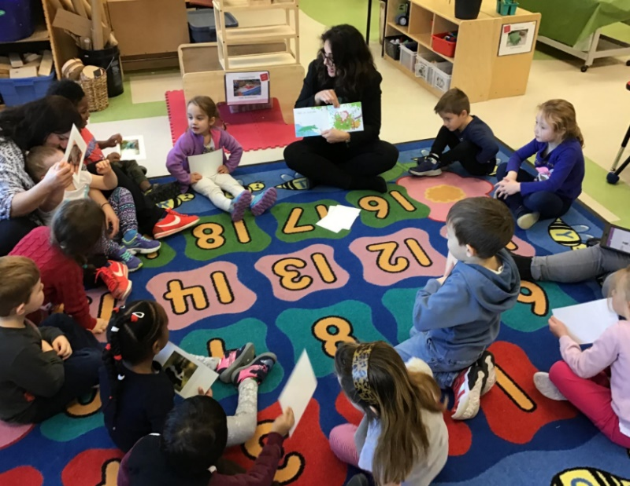
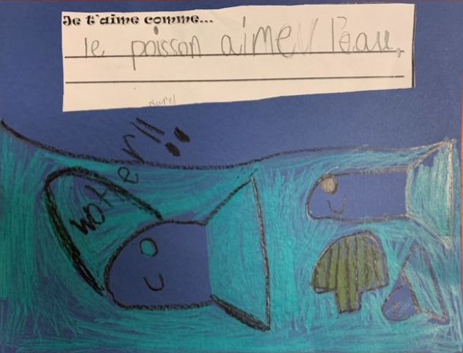
THE NLA CYCLE: WHAT COMES AFTER THE ORAL STAGES?
The educator uses and reuses the same structure and moves on to the reading and writing stages in a seamless transition. ``

