Slide 1
Mini Presentation
Inquiry and Play-Based Learning
with a Literacy Focus in French Immersion
Sophie Beaulne & Lorie Mason
Oral vocabulary is the essential springboard toward reading comprehension and phonological awareness.
Continuous modeling and intentional lexical targets woven directly into everyday play.
The educator provides the reference acoustic and lexical model.
Notes:
Bonjour à tous! Welcome to our mini-presentation.
Today, we want to address a central challenge that every French Immersion educator wrestles with daily: How do we deliver structured literacy instruction while maintaining a joyful, play-based kindergarten environment?
In French Immersion, young children enter our classrooms with zero or minimal French background. If we jump straight to decoding letters without building their oral foundation first, literacy becomes an abstract decoding exercise without meaning.

Slide 2
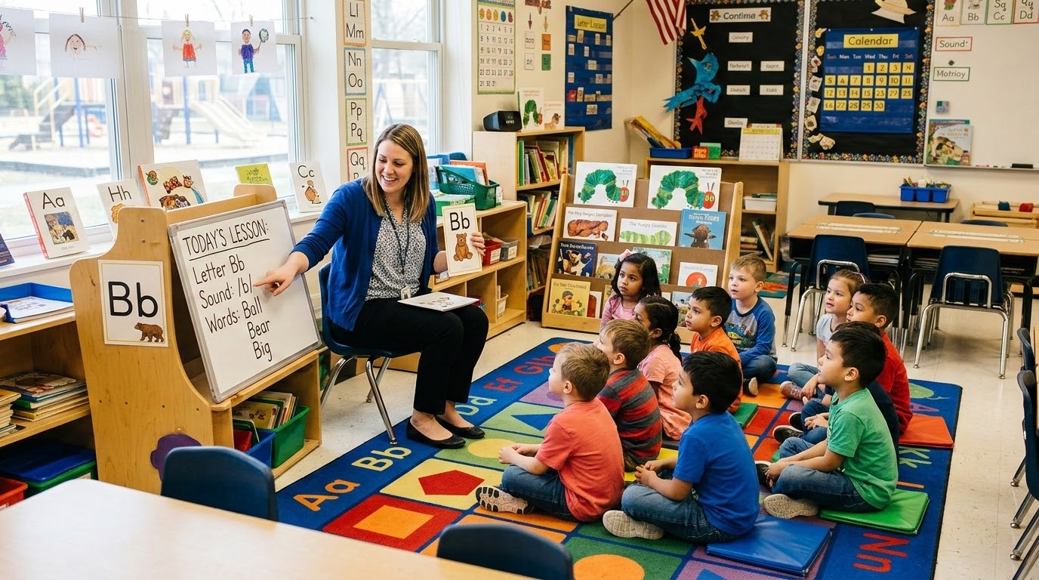
The Continuum of Play - Where Vocabulary Takes Roots
1
Educator-Directed
(Mini-Lesson)
~10 minutes of explicit instruction
• Explicit target mini-lessons: introduction of key phonemes (e.g., /u/)
• Rhythmic chants and songs to anchor French intonation
Visual anchors: gesture prompts & flash cards without English translation.and prosody.
Notes:
To balance structure and play, we look at the continuum of play-based learning.
Stage 1 is Educator-Directed.
This is a brief 10-minute mini-lesson, for example, during circle time or morning message. Here, we explicitly introduce target sounds like /u/ , accompanied by gestural cues, song, and visual supports.

Slide 3
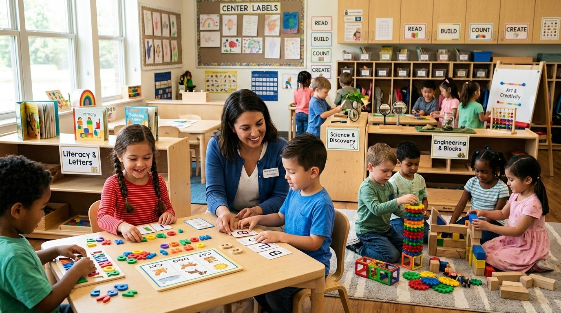
The Continuum of Play - Where Vocabulary Takes Roots
2
Guided Play
• Embedding mini-lesson targets: intentionally planting new words in centers.
• Sentence frames: providing structures like « Je vois.. » and « J'ai fait... ».
• Hands-on prompts: manipulative provocations tailored to oral goals.
Notes:
Stage 2 is Guided Play, what we call the 'Lexical Incubator.'
This is where the real magic happens. We take that explicit target and embed it directly into our learning centers. If our target is sentence structures like « Je veux... », « Je vois... », « Il y a... », « J'aime... » or spatial vocabulary like « sur » and « sous », we set up provocations in the blocks or pizza station where children naturally need those words to play.

Slide 4
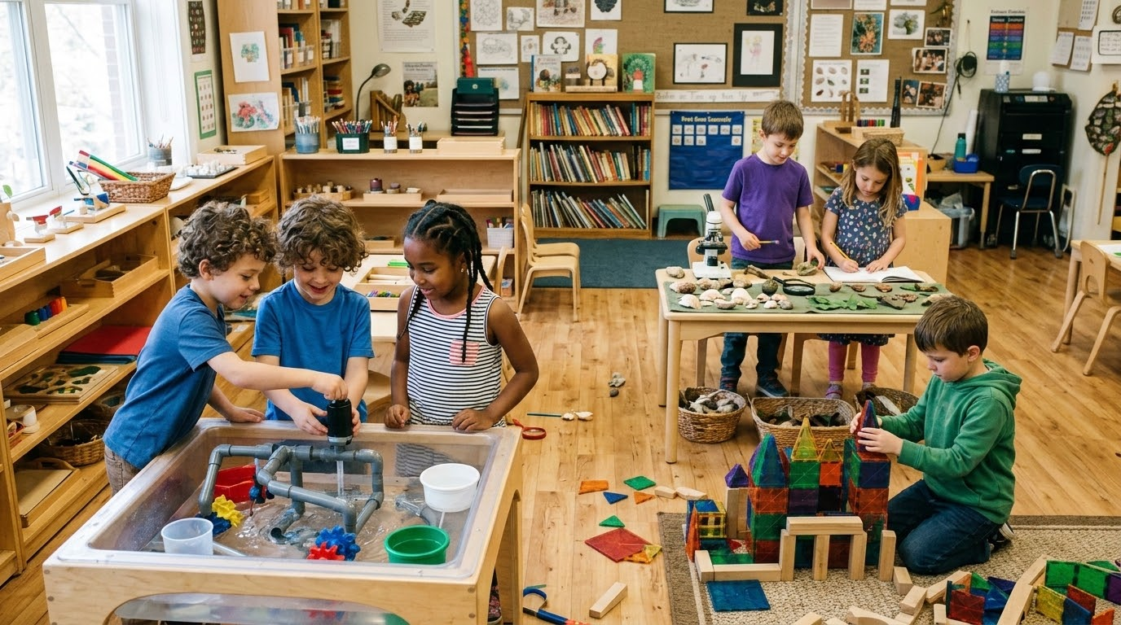
The Continuum of Play - Where Vocabulary Takes Roots
3
Free Inquiry
• Authentic self-expression: child navigates their own play storyline.
• Responsive co-construction: educators enter play as responsive language partners, not examiners.
• Continuous observation and documentation of spontaneous language.
Notes:
Stage 3 is Free Inquiry.
As children move into child-led exploration, we co-construct language in context. Play gives children an authentic reason to speak French.

Slide 5
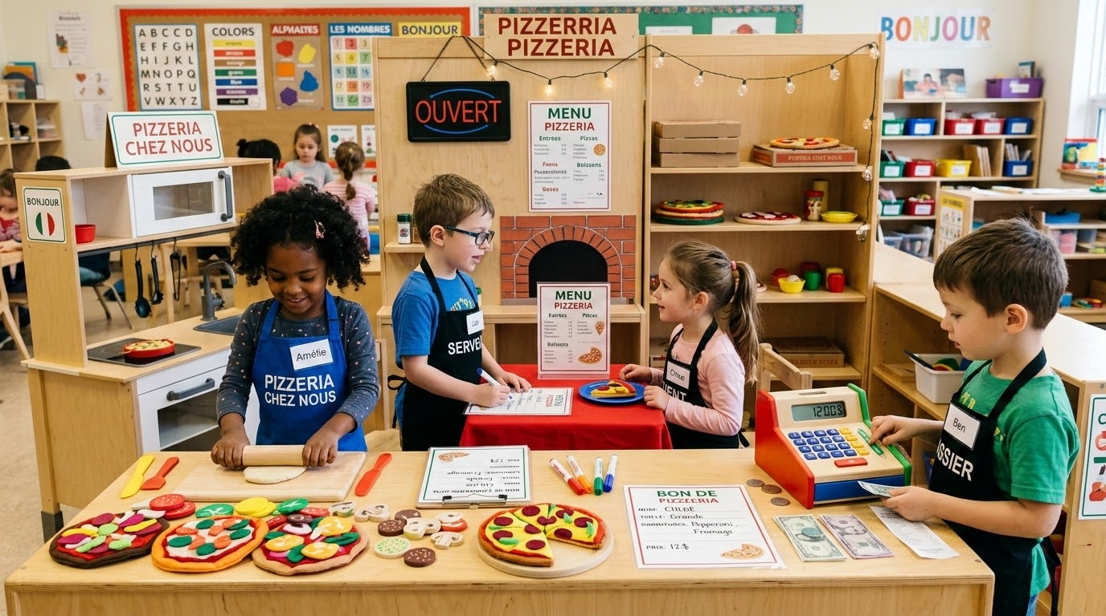
Practical Learning Centres in Action
Jeu dramatique
La pizzeria
Oral French vocabulary
Order forms
Menus
Initial sound sorting (/p/ pour pepperoni)
Notes:
Let’s look at how this plays out in three specific classroom centers:
At Dramatic Play (La pizzeria), our oral goal is functional vocabulary - pizza toppings and sentence frames like « Je veux... » or « Sur ma pizza, il y a…». The bridge to literacy happens naturally: children fill out visual order slips using emergent print, or sort toppings by initial sounds, like /p/ for pepperoni.

Slide 6
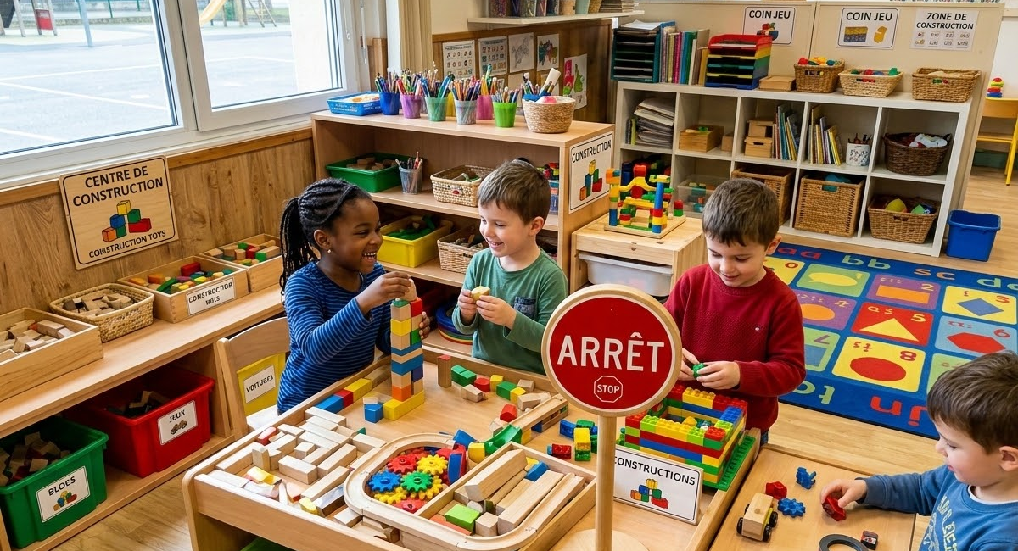
Practical Learning Centres in Action
Centre de construction
Blocks
Spatial terms (sur, sous)
Environmental print (Arrêt, noms de restaurants et noms de magasins)
Notes:
In the Construction Centre (Les blocs), we target spatial vocabulary - « sur », « sous », « en haut », « à côté » - and comparative terms like « plus gros » or « plus petit ». We connect this to literacy through environmental print, like mini blueprint signs or stop signs (« Arrêt »).

Slide 7
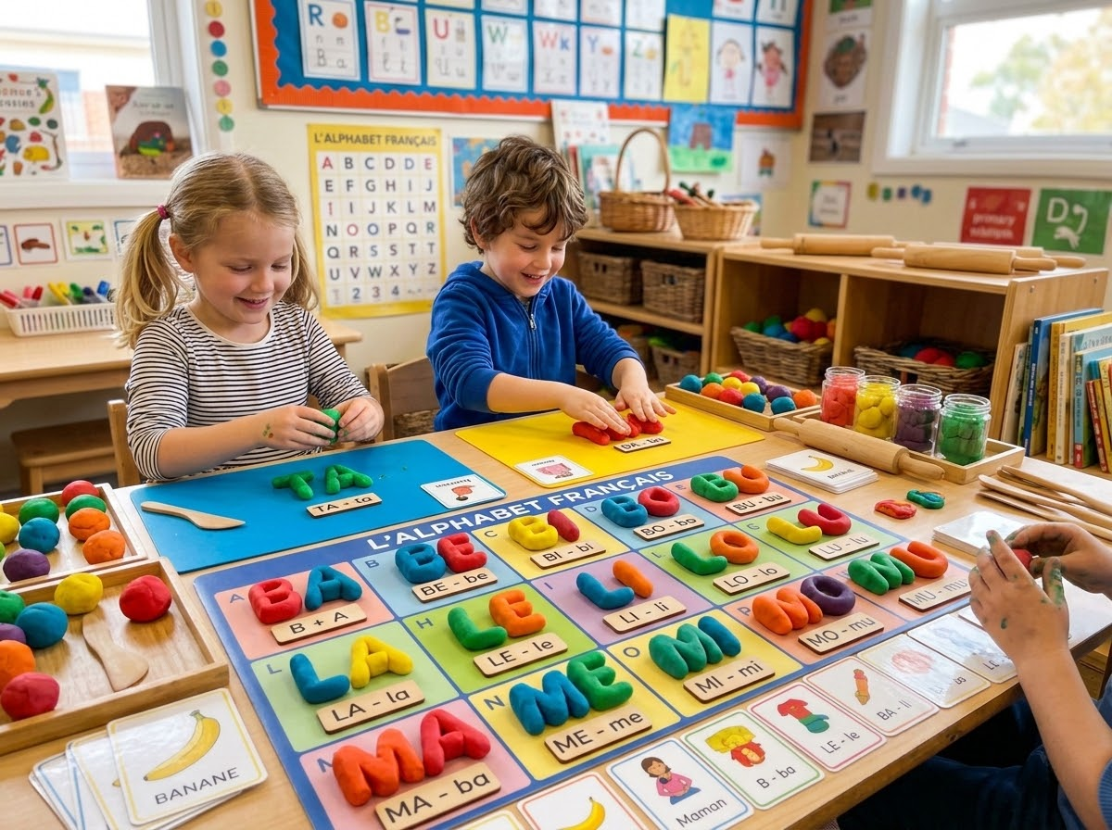
Practical Learning Centres in Action
Table de manipulation
Syllable clapping with clay (pa-pi-llon)
Playdough letter formation
Notes:
At the Sensory Table, we target descriptive structures like « C'est une paire » or « Ce n'est pas une paire ». Here, phonological awareness thrives: students clap syllables in French words while flattening playdough balls - « pa-pi-llon » or bend pipe cleaners to feel letter formations.
In every case, oral vocabulary is built first, giving meaning to the print they encounter.

Slide 8
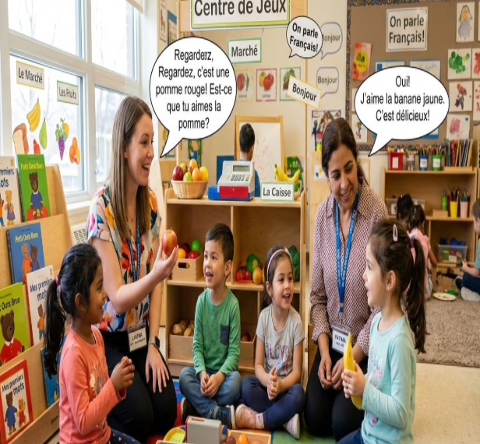
OCT & DECE Collaboration & Prompting
Parallel Play Technique
Parallel Play & Co-Play Strategy
One Educator in Small Group
Explicit phonological instruction, target sound discrimination, and syllable blending.
Co-Educator in Parallel Play
Plays alongside children at centers, modeling rich and natural French dialogue.
Notes:
A strong partnership between the Ontario Certified Teacher and Early Childhood Educator (DECE) is vital in an immersion classroom. Using the Parallel Play Technique, while one educator leads a small-group phonemic awareness guided session, the other plays alongside children in the centers, modeling rich French dialogue in real time.

Slide 9
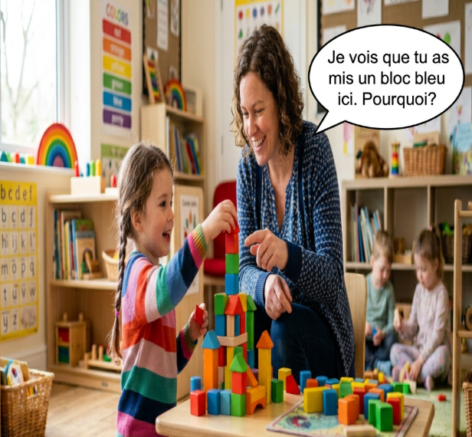
OCT & DECE Collaboration & Prompting
Shift to Co-creation
Avoid Interrogation:
« C'est quelle couleur ? » (induces linguistic anxiety and limits children to one-word answers).
BLOCK CENTRE
Educator: « Qu’est-ce que tu as fait ? » [What did you make?]
Student: « Maison. » [House.]
Educator: « J’ai fait une maison ? » [I made a house?]
Student (smiling): « J’ai fait une maison ! » [I made a house!]
Notes:
Crucially, it's best to shift from interrogation to co-creation. Asking a child « C'est quelle couleur ? » puts them on the spot and yields a single-word answer like « rouge ».
Instead, look at the recasting dialogue on the right.
When a student builds a house and says a single word - « Maison » - the educator doesn't correct them or say 'No, say a full sentence.' Instead, the educator gently recasts with rising intonation: « J’ai fait une maison ? »
The student smiles, internalizes the structure, and repeats: « J’ai fait une maison ! »
This provides linguistic security. We validate their message, gently model correct syntax, and build their confidence to move from isolated nouns to complete thoughts.

Slide 10
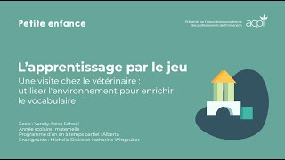
Interactive Activity
How did the educator frame an open-ended French inquiry prompt without interrupting their play?
What 3 oral target words would you prioritize?
What emergent literacy or phonemic awareness opportunity could you weave in?
Notes:
To wrap up our presentation, let’s look at a real-world scenario.
Watch this video of an educator playing in a veterinary center with her students.
I invite you to turn to your neighbor for the next 60 seconds and discuss these three questions:
How did the educator frame an open-ended French inquiry prompt without interrupting their play?
What 3 oral target words would you prioritize?
What emergent literacy or phonemic awareness opportunity could you weave in?
(Pause 60 seconds for audience discussion)
Excellent. You might ask « Qu'est-ce qu'il a, ton animal ? », model sentence frames like « Mon animal a mal à... », or prompt them to isolate the initial sound in chien (/ch/) or tortue (/t/).

Slide 11

Takeaway:
Play is the engine that drives language acquisition
Notes:
To leave you with our core takeaway: In French Immersion, we must give children the oral words to play first - they will naturally learn to read and write them next.
Merci beaucoup!

