Slide 1
Mini Presentation
Backwards Design using the CEFR Descriptors
Danielle Hunter and Amy Turner

Slide 2
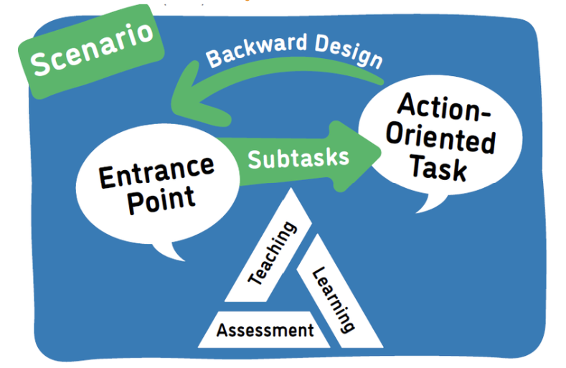
Planning with Backward Design
Notes:
Danielle

Slide 3
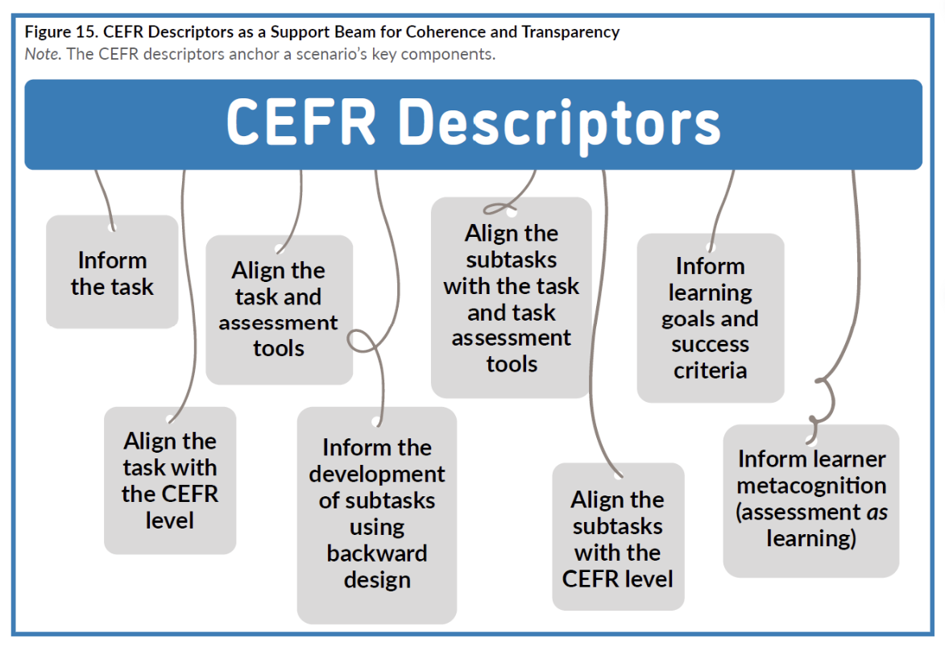

Using CEFR Descriptors
Notes:
Danielle

Slide 4
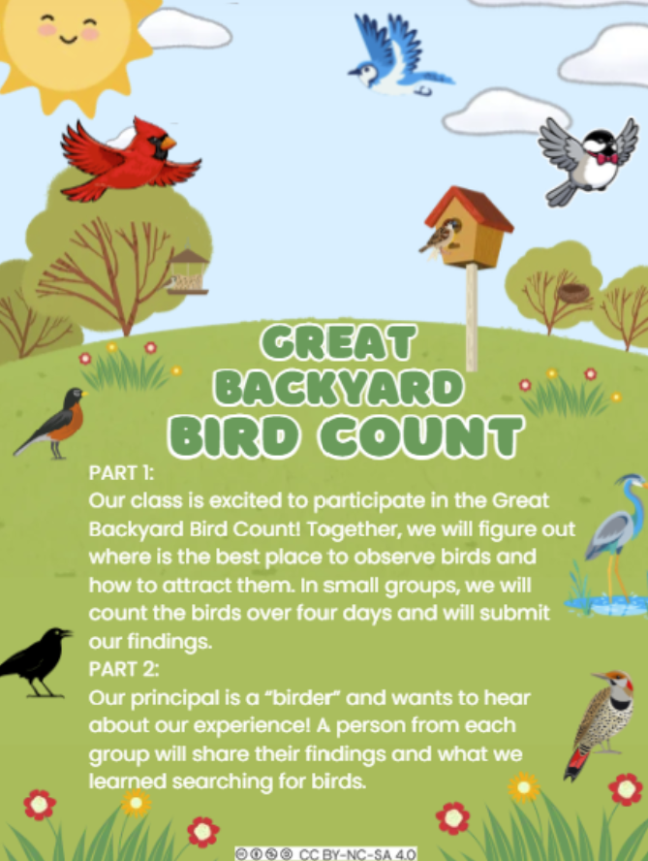
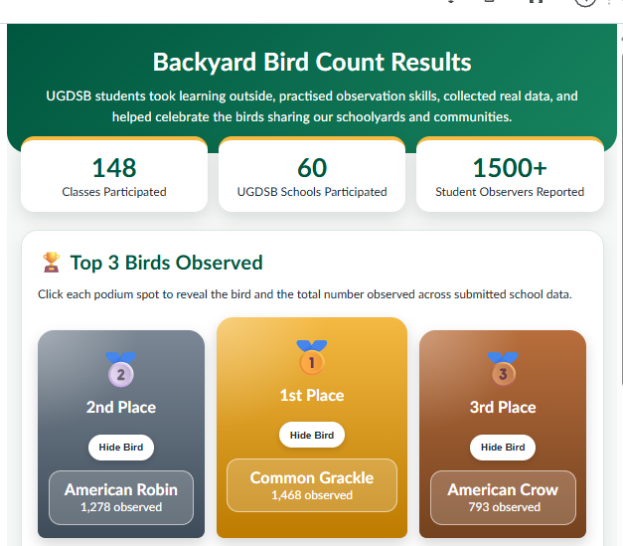
Backyard Bird Count
Notes:
Danielle then Amy UGSB Bird count)

Slide 5
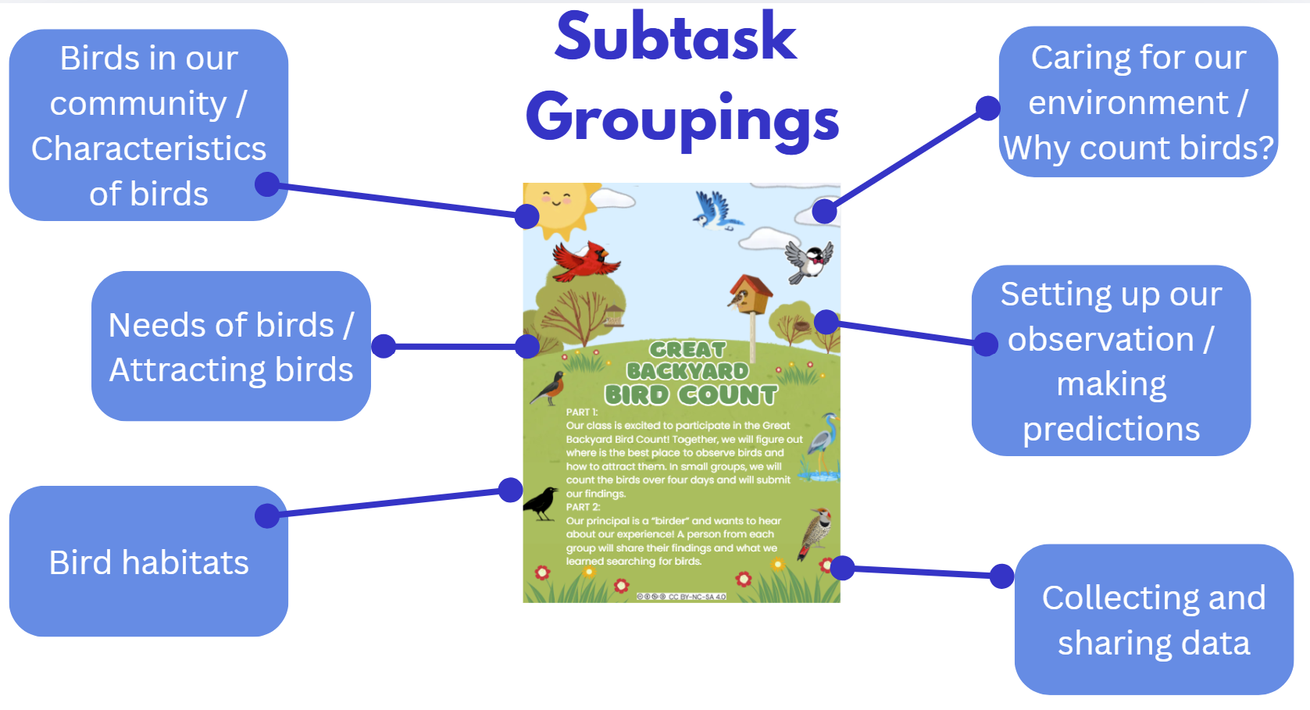
Subtasks*
Where do birds live?
Show pictures of different bird habitats and invite learners to match familiar birds to places they might live
Bird habitat detectives
Take a nature walk and look for evidence of bird friendly spaces
Different birds, different homes
Compare the homes of two different birds
Building bird nests
Can you build a nest that holds three eggs?
Wetland sensory bin
Backward design
*Subtasks ideas were generated by AI
Notes:
Danielle

Slide 6
Curriculum connections
C16. Understanding Health Concepts
C16.1: demonstrate an understanding of the effects of healthy, active living on the mind and body.
C16.2: investigate the benefits of nutritious foods and explore ways of ensuring healthy eating
C16.3: practise and discuss appropriate personal hygiene that promotes personal, family and community health.
A1 Oral and Non-Verbal communication
a1.1 Listen and respond
C14. Social Skills
C14.1: act and talk with peers and adults by expressing and accepting positive messages.
Notes:
Amy -

Slide 7
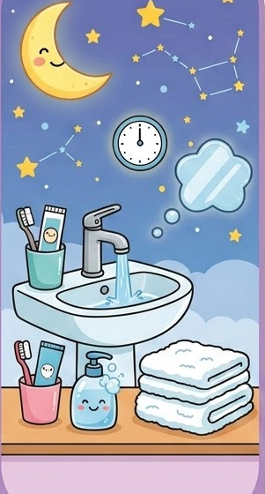
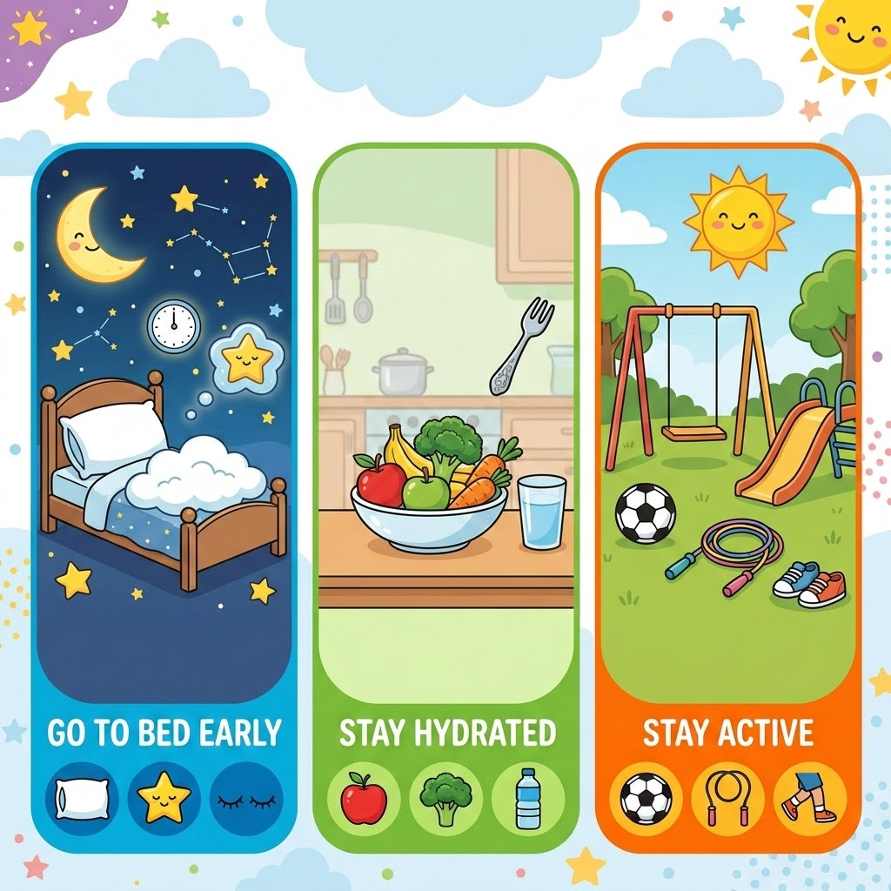
Tâche Finale:
Aider notre ami à être en bonne santé
Aujourd'hui, notre ami Luc ne se sent pas bien et n'a pas de l'énergie pour jouer pendant la récréation. Toute la classe veut l'aider ! On partage des idées pour aider Luc à prendre soin de lui à la récréation, à la maison et à table. Ensemble, on aide Luc à découvrir de bonnes habitudes pour être en santé. Aussi, on prépare une carte pour Luc qui dit « Bon rétablissement ! »
Images created with AI
Notes:
Amy

Slide 8
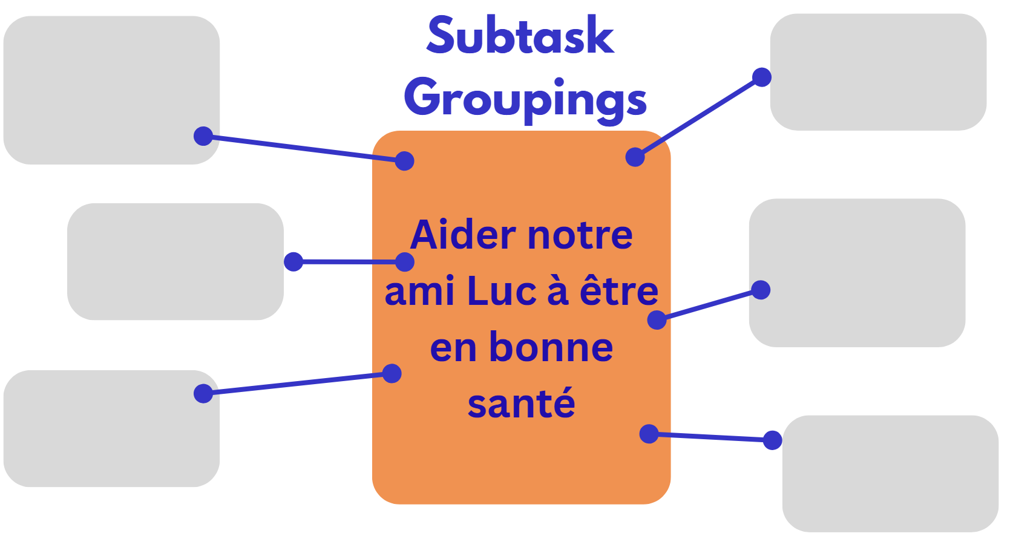
Creating Subtask Groupings
What do my students need to learn to be successful in achieving the final task?
Notes:
Danielle

Slide 9
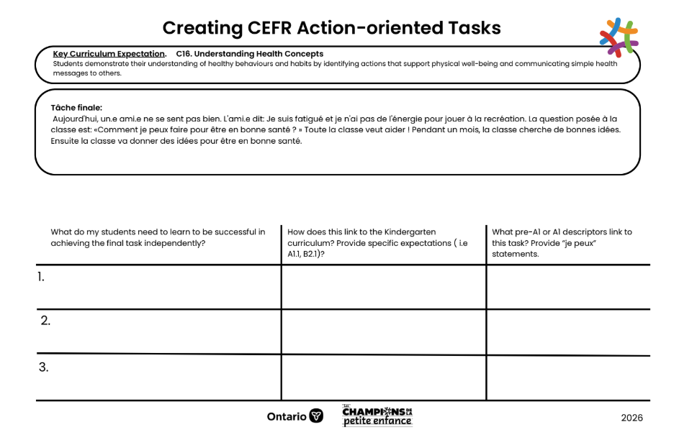
Building Subtasks
1. Think about the subtask groupings. What do students need to learn to be successful in achieving the final task? Give a suggestion for a subtask (and connect it to the subtask grouping).
If time:
2. How does this link to the Kindergarten curriculum? Provide specific expectations ( i.e A1.1, B2.1)?
3. What pre-A1 or A1 descriptors link to this task? Provide “je peux” statements.
Notes:
Amy - give an example ie brushing teeth

Slide 10
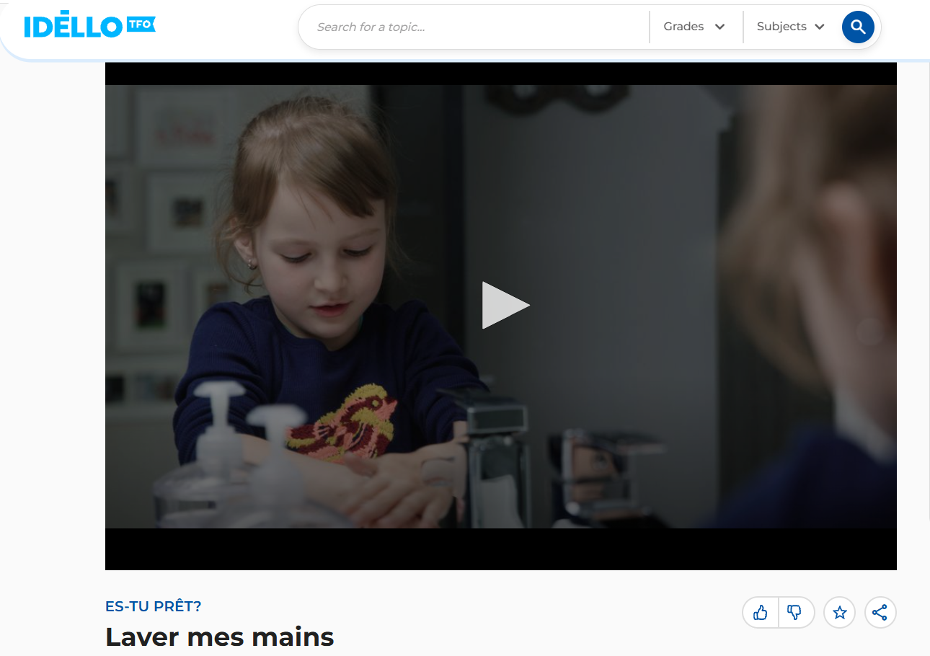
Sample Sub Task

Slide 11
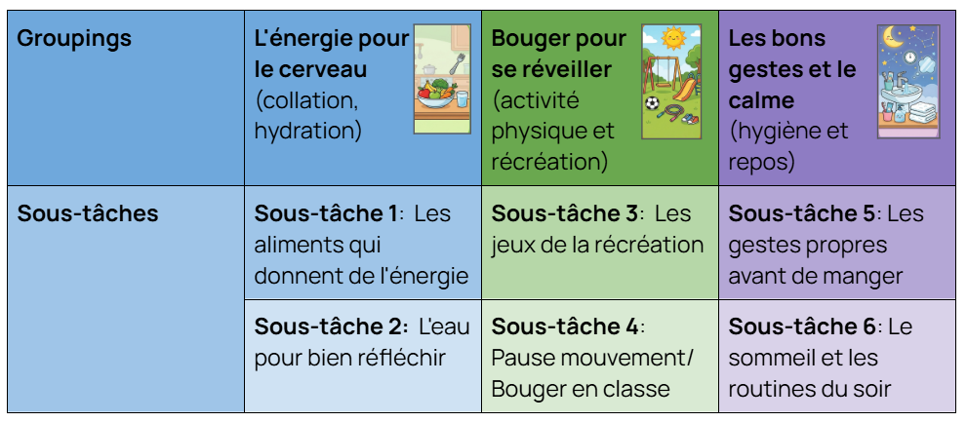
Possible Groupings and Sub-tasks

Slide 12
Tools
Kindergarten Curriculum
Pre A1 and A1 Descriptors

