Slide 1



Tableau de création de questions
Tableau de création de questions by Andrea Vogan and other FSL teachers for Halton District School Board, with collaboration from Muriel Péguret for revision. CC-BY-NC-SA

Slide 2
Rights of Use for this Resource
For educational purposes, teachers can:
download it
modify it
project it in class
post it on their classroom LMS
Reshare the original or a modified version on any educational website.
Teachers can’t sell this resource and can’t modify the applied CC license when resharing it even in modified version (CC-BY-NC-SA)
When sharing a modified version of this resource, you are required to credit the original author(s) and you can also add your name using this template :
This resource, <Your modified title>, is adapted from tableau de creations de questions by Andrea Vogan and other FSL teachers for Halton District School Board, used under license CC-BY-NC-SA. <Your modified title> is licensed under CC-BY-NC-SA by <Your name>.

Slide 3

Benefits of Using Graphic Organizers
The use graphic organizers in the classroom has gained significant attention as an effective strategy for enhancing second language acquisition, including French. This template provides a dynamic, communicative resource where learners are encouraged to practice using new vocabulary, improve communication, and apply grammar in context—all while fostering a sense of enjoyment and collaboration (Doughty and Long, 2003).
Research has consistently highlighted the benefits of authentic practice of scaffolded language learning, underscoring their positive impact on engagement, fluency, and cognitive development (Deci, Vallerand, Pelletier, & Ryan, 1991). Below are several key student outcomes of using this strategy.
Building schema for oral fluency
Vocabulary learning, practice and retention
A structured approach to the writing process (enhancing organizational and planning skills)
Increased motivation and engagement
Facilitation of authentic communication
Reinforcement of target grammar and vocabulary
Notes:
Doughty, C. J., & Long, M. H. (2003). A Handbook of Second Language Acquisition. Malden: Blackwell.
https://doi.org/10.1002/9780470756492
Deci, E.L., Vallerand, R.J., Pelletier, L.G. and Ryan, R.M. (1991) Motivation and Education: The Self-Determination Perspective. The Educational Psychologist, 26, 325-346.
http://dx.doi.org/10.1080/00461520.1991.9653137

Slide 4
Rights of Use for this Resource
For educational purposes, teachers can:
download it
modify it
project it in class
post it on their classroom LMS
Reshare the original or a modified version on any educational website.
Teachers can’t sell this resource and can’t modify the applied CC license when resharing it even in modified version (CC-BY-NC-SA)
When sharing a modified version of this resource, you are required to credit the author and you can also add your name using this template :
This resource, <Your modified title>, is adapted from Tableau de création de questions by Andrea Vogan and other FSL teachers for Halton District School Board, used under license CC-BY-NC-SA. <Your modified title> is licensed under CC-BY-NC-SA by <Your name>.

Slide 5
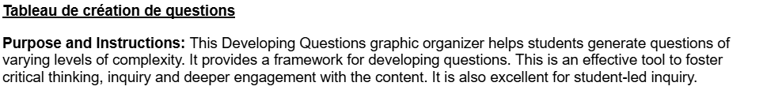
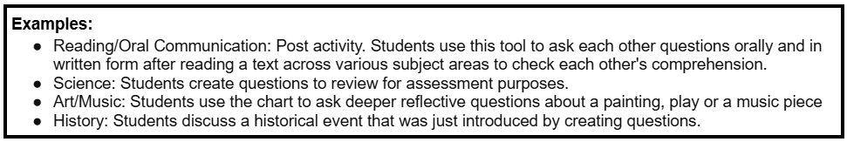
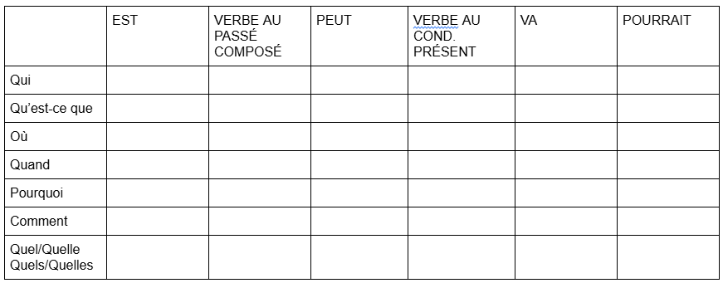

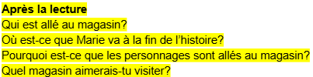

Slide 6

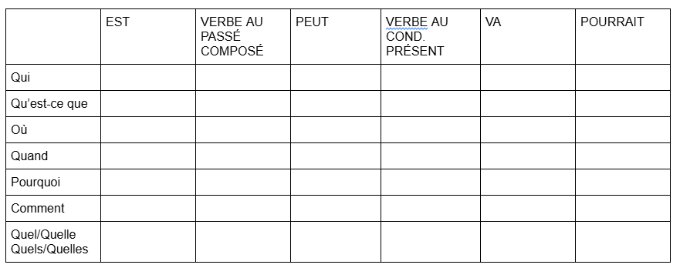
Nom:_____________

